Slide 1

TME bulletin system
Loading NMSC Bulletins
TOYOTA MOTOR EUROPE
TOYOTA

Slide 2
Bulletins - User Guide – How to write in TD3
Writers: A. Los, M. De Wever
Date: v1: 28/09/2012
Change Log
28/09/2012 D. NMSC bulletins: add process

Slide 3
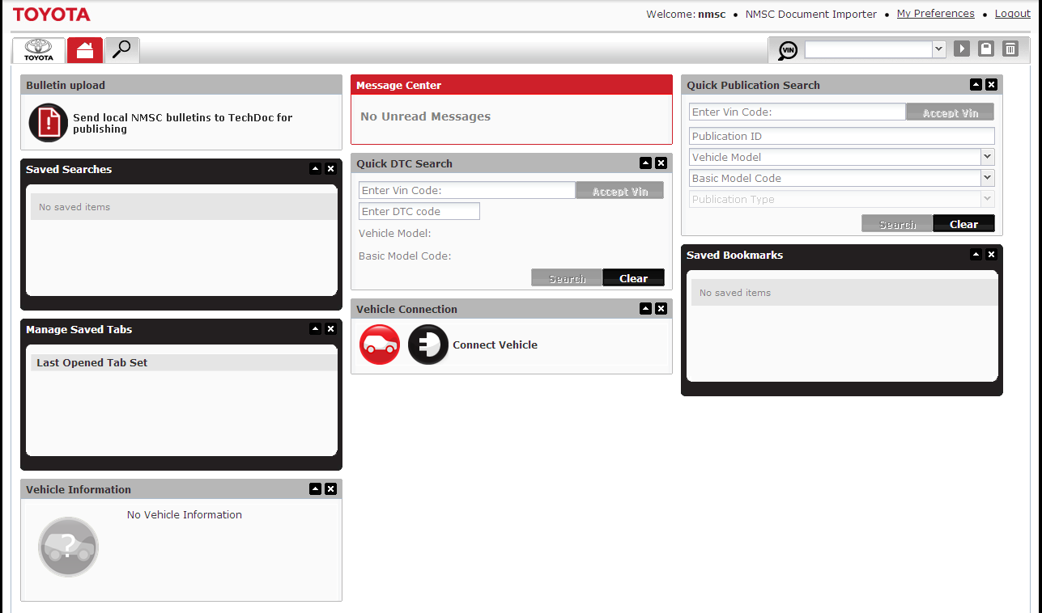
D. 1.1 Launch The bulletin / Open application
This widget provides a link to a specific
load screen of the bulletin application.
Click the text or icon to open the
bulletins application
The NMSC user with rights to load local market bulletins has a link on Techdoc 3:
http://mytechdoc.toyota-europe.com

Slide 4
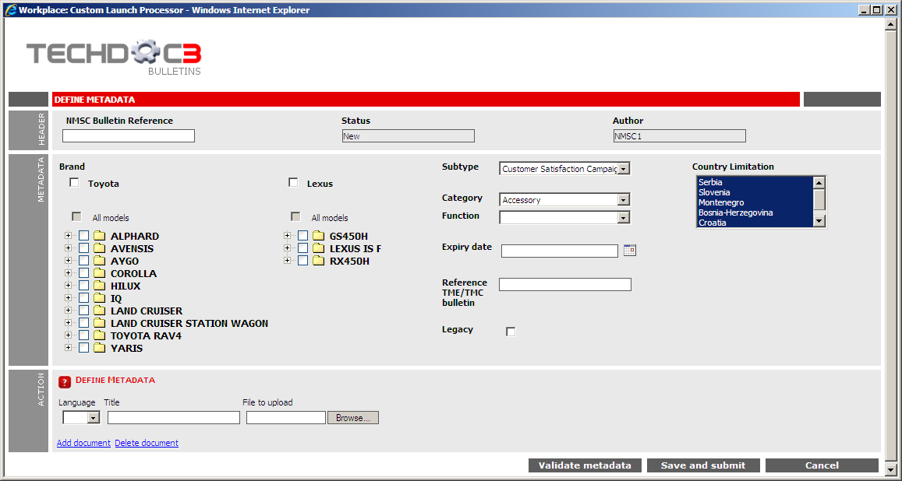
D. 1.1 Launch the Bulletin / Automated metadata
Automatically added as metadata:
Status, Author, (Publication) Type, Source, Language,
Toyota/Lexus NMSC distributor code
A bulletin is created in 2 levels
metadata: to be filled out in TD3, will be automatically filled out in the word document
PDF document: load the local market bulletin in (a) specific language(s)

Slide 5
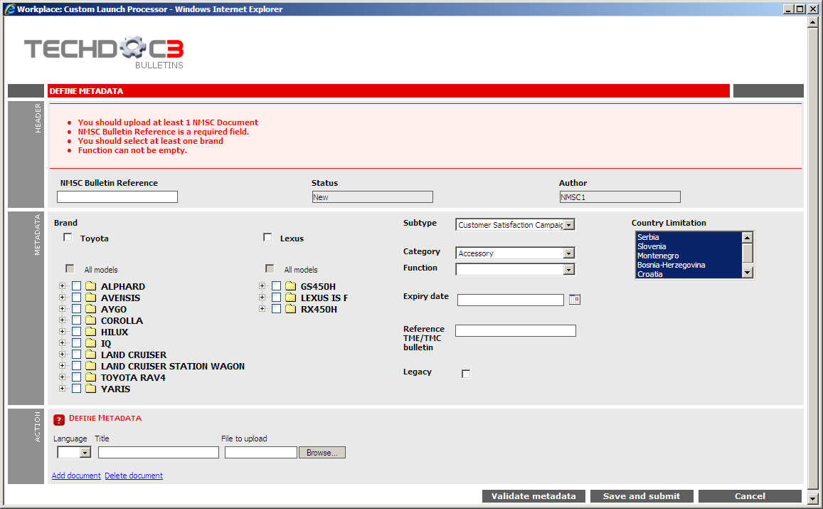
D. 1.1 Launch the Bulletin / Manual metadata
The following information is mandatory:
- A reference number for the NMSC bulletin
- Select at least one brand, model, model code (or all models)
Select a function
Upload at least one bulletin in pdf format
language and title of each bulletin to upload

Slide 6
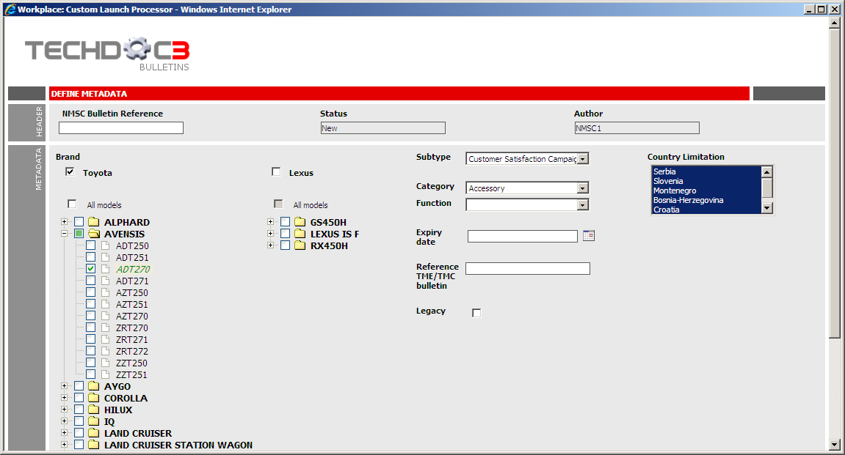
A. 1.1 Launch the Bulletin / Manual metadata
Select one (or both) brands
Select a model. You can only select a model once the related brand is selected
Select or deselect a given model code(s).
  By expanding a model, the user can select and deselect
  model codes for that particular model.
  For each model selected, at least one model code has to be chosen.
  Some cases appear twice, then only select one
  (e.g. Auris / Corolla: NDE150)
Optional “All models” (In case bulletin applicable for all models)

Slide 7
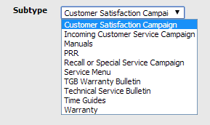

A. 1.1 Launch the Bulletin / Manual metadata
1. The bulletin number as known by the NMSC
2. Select the type of bulletin
Important:
Do not use the “TGB warranty” subtype.
This is reserved for TGB and has
restriction on who can view.
3. Select applicable
Category and Function
4. Select for which countries the bulletin is applicable for that NMSC
This allows a user of TD3 to filter NMSC bulletins based on countries
5. Optional: Set the expiry date of the bulletin. Currently, there is no process in place to automatically hide bulletins once the date expired. This info is only stored for future functionality
7. Optional: Legacy - Select whether the bulletin was already made available.
Check this box if you do NOT want to generate a message Centre message
6. Optional: Add the bulletin number of a related the TME/TMC bulletin

Slide 8
A. 1.1 Launch the Bulletin / Add PDF bulletin
Add one pdf file for the local market bulletin for each applicable language
Browse button to search for the file to upload
Source location of the file to upload
Enter the title of the bulletin in the corresponding language
Indicate the language of the pdf file
Adds a new row to upload a file in an additional language. You will get the same fields as the first row.
Validate whether all the information is correctly filled in.
Save and send the files to publish on TD3. It will validate the metadata before sending the files.
Remove an existing row to upload a file. The last row can’t be deleted since at least one document is required
Cancel the load of a NMSC bulletin. This will close the screen.

Slide 9

End

